Slide 1
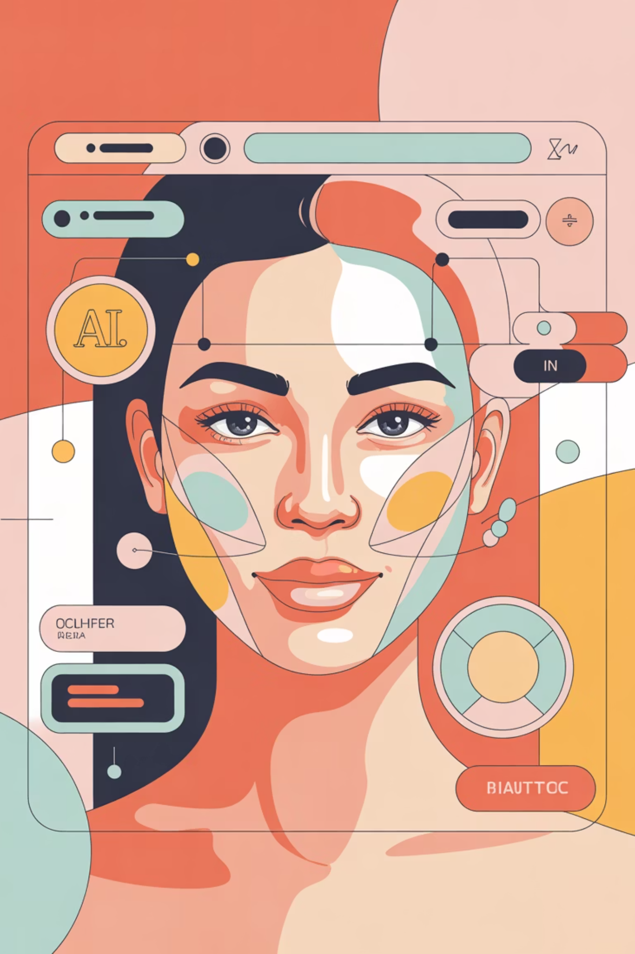
Elevating Personal Expression: Transforming Everyday Style & Beauty with Intelligent AI
Reimagining how individuals interact with style, beauty, and self-expression — powered by multimodal AI that sees, listens, and guides. This modern AI turns routine style decisions into personalized, confidence-boosting experiences with measurable engagement and significant business opportunity.

Slide 2
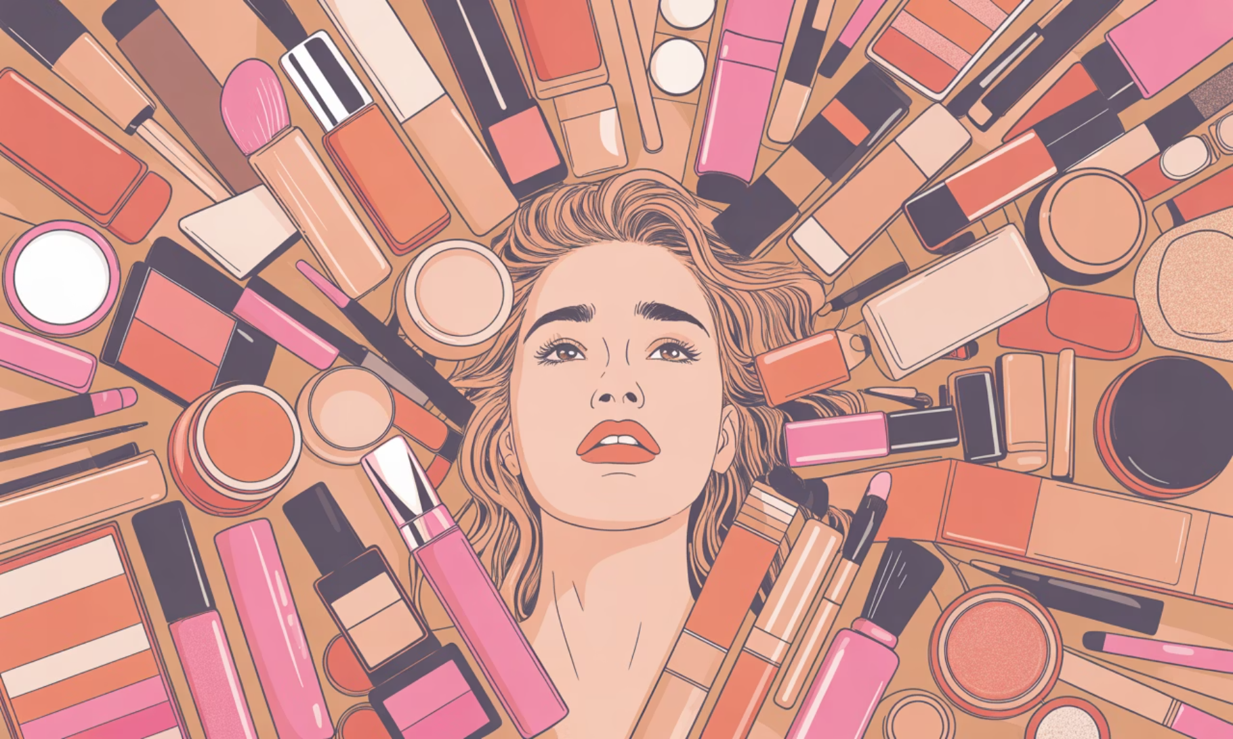
The Problem: A Gap in Personalized Style Guidance
Lack of Personalization
Consumers struggle to find instant, reliable, and truly personalized beauty and style advice tailored to their unique features.
Fragmented Information
Current solutions are often generic or require extensive manual input, failing to integrate visual, auditory, and textual cues for holistic recommendations.
Market Opportunity
A clear demand exists for an AI system that combines vision analysis, voice, and text to deliver contextual, actionable style insights.

Slide 3

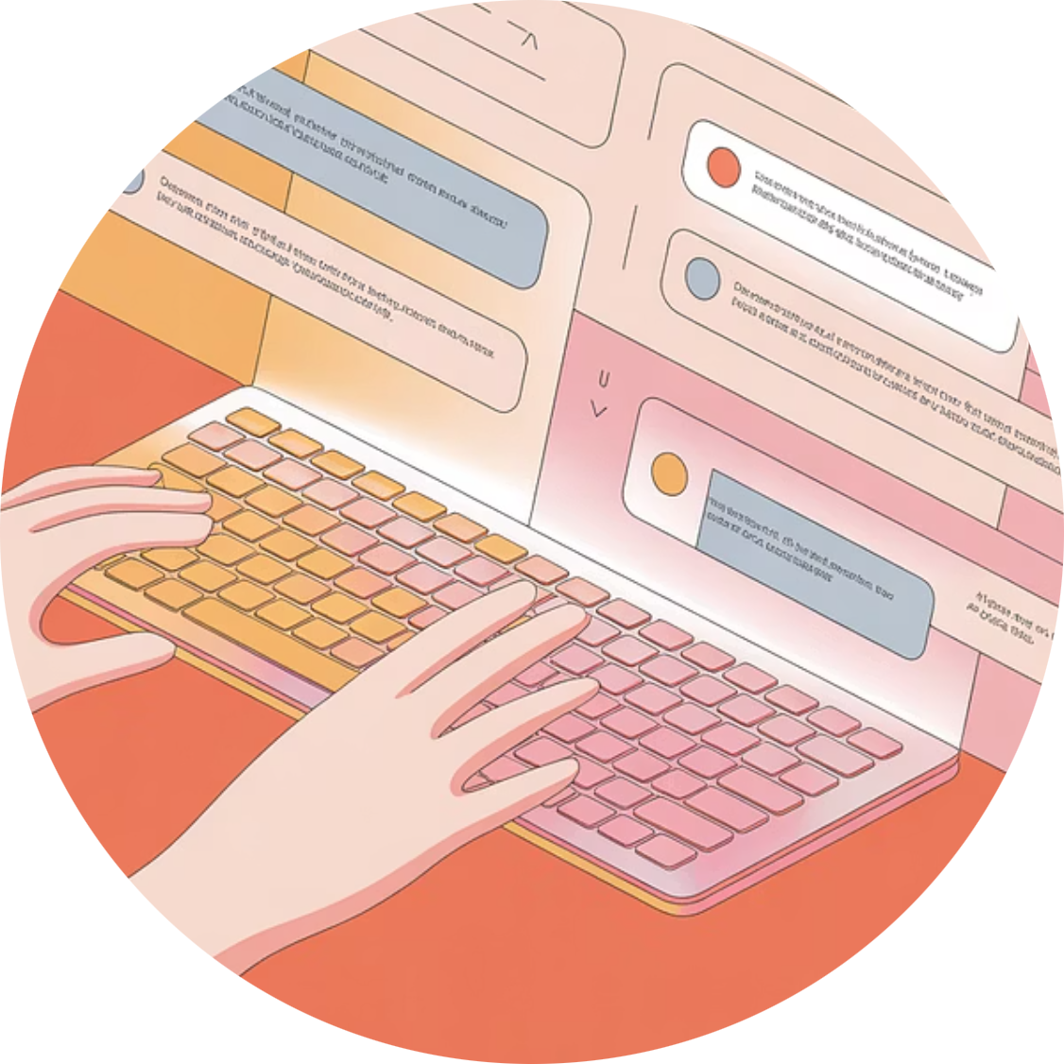
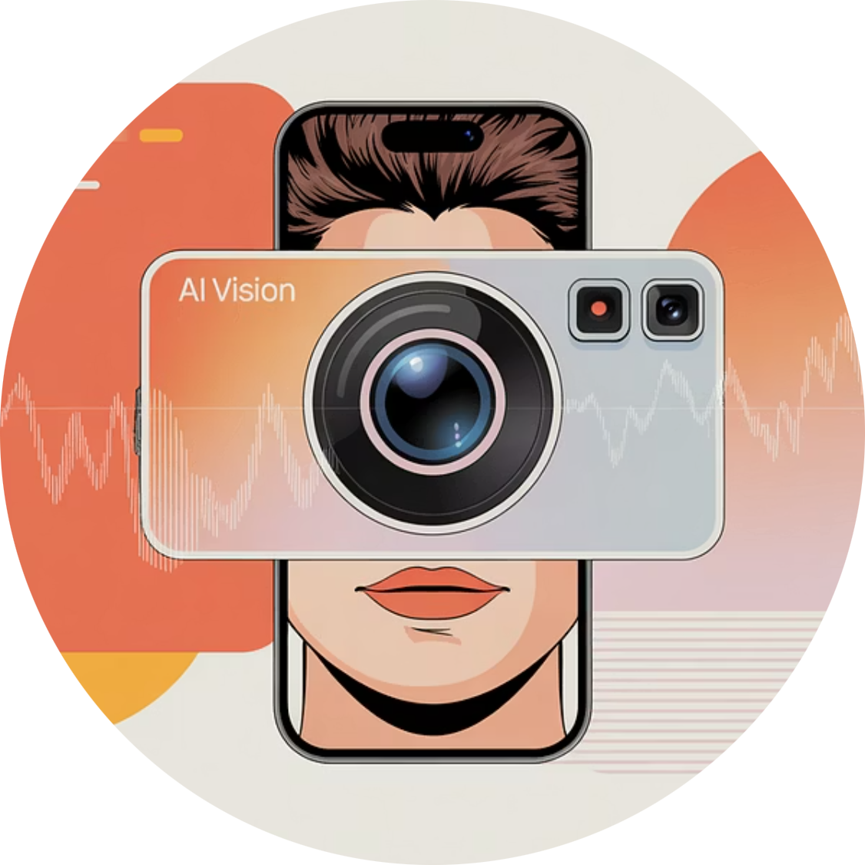
Introducing the AI-Powered Style & Beauty Assistant
Our interactive AI assistant revolutionizes personal style by understanding you in a way no static guide ever could. It accepts diverse inputs to deliver hyper-personalized recommendations.
Voice Input
Text Prompts
Image Analysis
Describe your style goals or ask specific questions naturally.
Engage in a chat for detailed advice or quick tips.
Upload photos or use live camera for real-time feature interpretation.

Slide 4
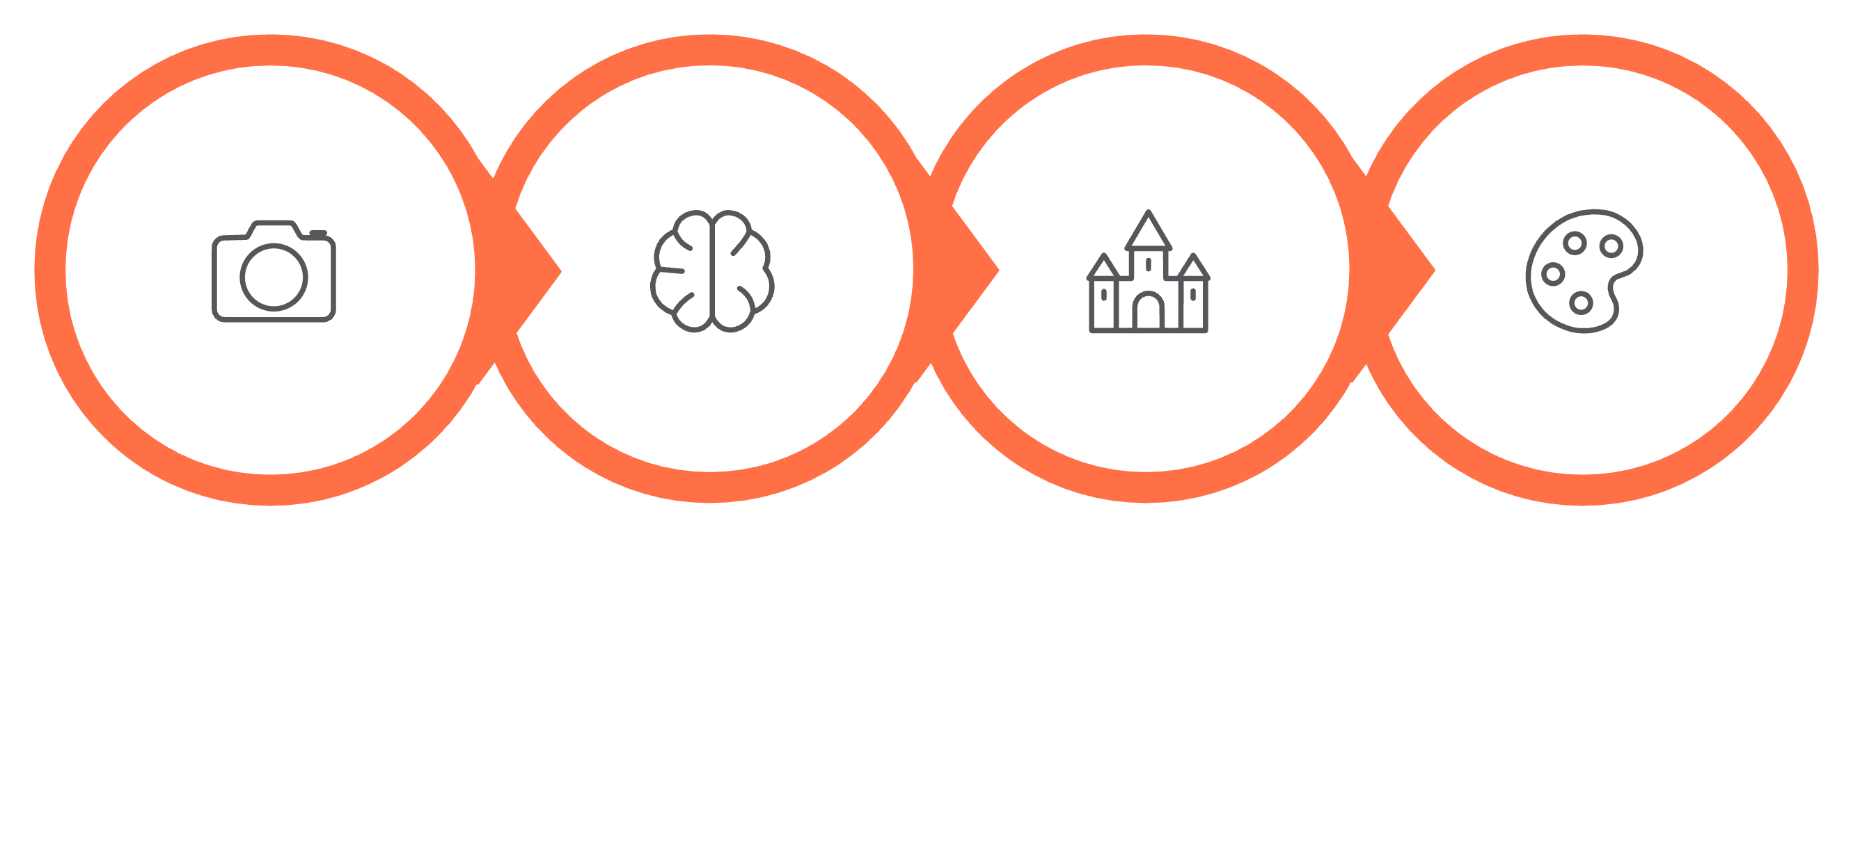

How It Works: Seamless User Experience Flow
Image Capture
AI Conversation
Personalized Suggestions
AI Analysis
This intuitive process allows users to effortlessly transform their real-world style challenges into personalized, actionable recommendations, fostering confidence and engagement.

Slide 5
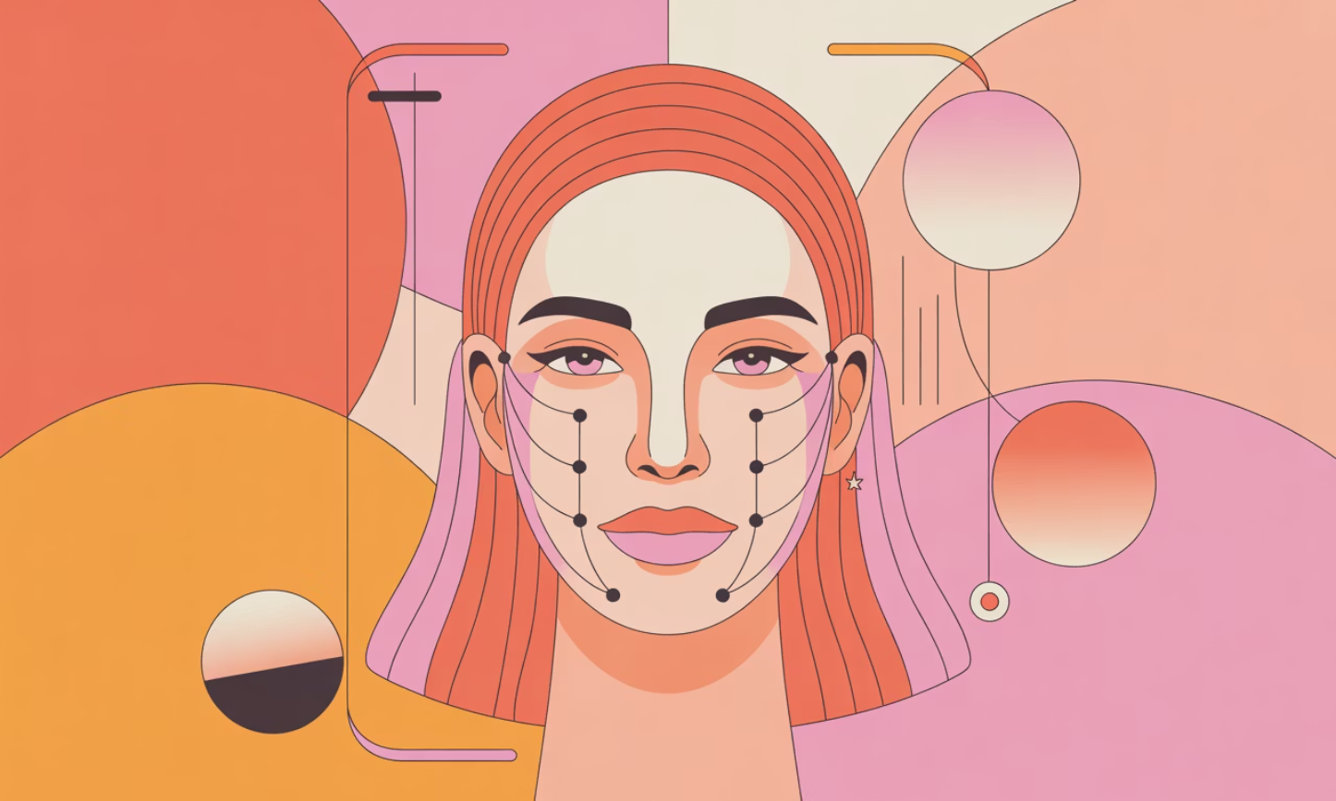
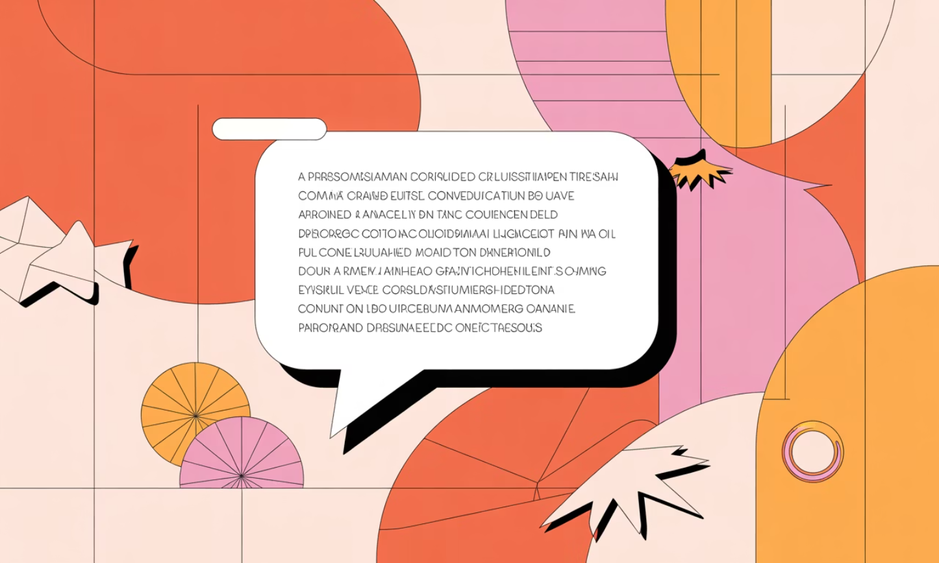
Key Features & Intelligent Capabilities
Multimodal Input
Accepts camera images, voice recordings, and text for flexible, natural interaction, adapting to user preferences.
Vision-Driven Analysis
Advanced AI interprets facial attributes, skin tone, and existing hairstyles to generate highly accurate makeup and hair suggestions.
LLM Powered Insights
Conversational advice and contextual recommendations are delivered via advanced Large Language Model prompting, providing expert-level guidance.
User-Centric UI
A modern, React-based chat interface ensures intuitive interactions, making complex AI accessible and enjoyable for every user.

Slide 6
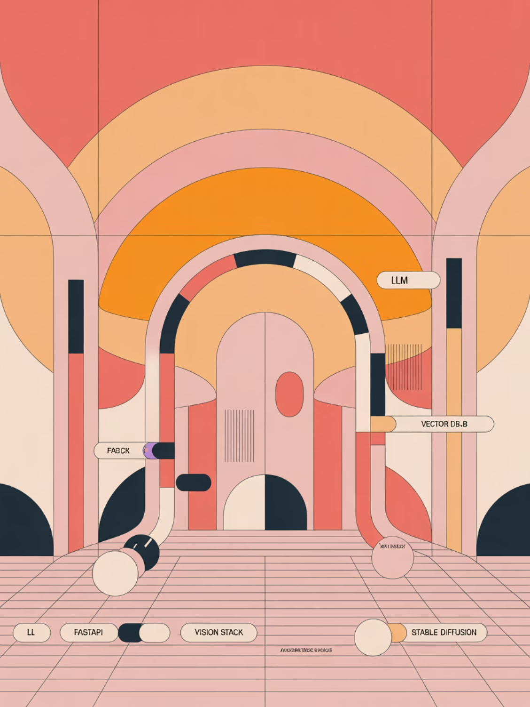
Technology Architecture: Powering Intelligent Style
Our robust backend integrates cutting-edge AI models to provide real-time, accurate, and creative beauty and style recommendations.
Backend Foundation: FastAPI for high-performance API services, integrated with a powerful Vision stack (DeepFace, MediaPipe, OpenCV).
Contextual Personalization: Vector database for efficient retrieval and personalization based on user history and preferences.
Enhanced Visual Outputs: Stable diffusion models generate high-fidelity visual recommendations, bringing ideas to life.
Expert Guidance: LLM prompting ensures expert-like, nuanced style advice delivered conversationally.

Slide 7
Driving Business Value & Key Performance Indicators
20-30%
10-15%
3x
Increased Engagement
Conversion Potential
Monetization Streams
Projected increase in time on app and repeat sessions through personalized, addictive interactions.
Estimated conversion rate for affiliate integrations with leading beauty and fashion brands.
Diverse models including subscriptions, in-app purchases, and partner API access for scalable revenue.
Our AI assistant is designed not just for user delight, but for significant commercial growth and brand partnership opportunities in the vast beauty and fashion market.

Slide 8
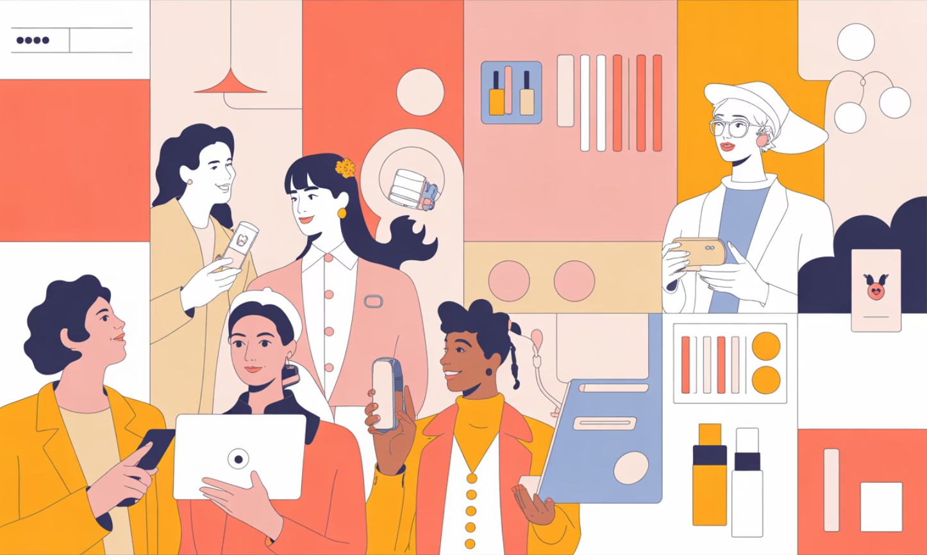

Commercialization Strategy & Growth Roadmap
Target Segments
Beauty Enthusiasts: Early adopters seeking cutting-edge personalization.
Industry Professionals: Stylists, makeup artists leveraging AI for client consultations.
Retailers & Brands: Integrating AI for enhanced customer experience and sales.
Go-to-Market
E-commerce Partnerships: Integrate with major fashion/beauty platforms.
Salon & Boutique Collaborations: Enhance in-store customer experiences.
AR Try-On Platforms: Embed for real-time virtual product trials.

Slide 9
Future Vision: Expanding Capabilities
Enhanced AR Previews
Dedicated Mobile App
Develop more sophisticated augmented reality features for real-time virtual try-ons of makeup, hairstyles, and accessories.
Launch a standalone application for seamless, on-the-go access and enhanced user experience.
International Expansion
Real-Time Virtual Trials
Localize content and expand market reach to key international beauty and fashion hubs.
Implement live camera integration for instant style alterations and feedback, transforming the virtual consultation experience.

Slide 10
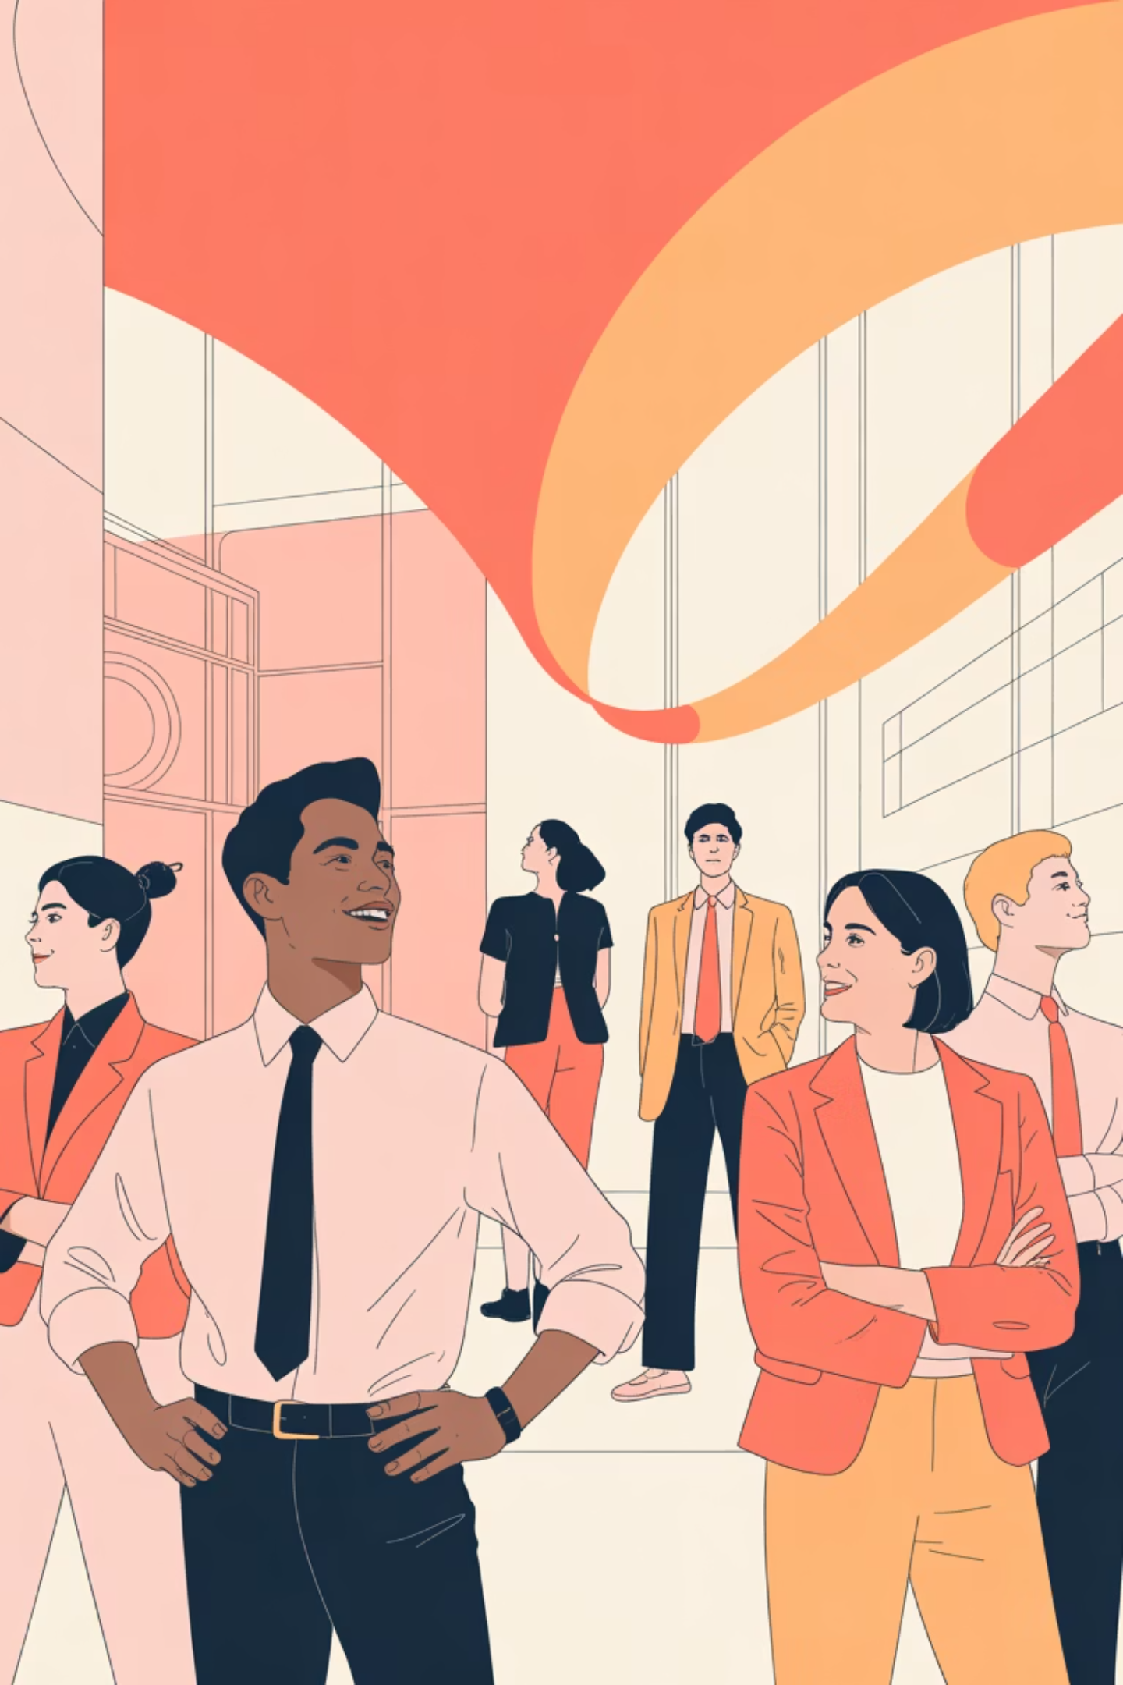

Leading the Future of Personalized Style & Beauty
This AI-driven assistant is more than just a product; it's a strategic move to capture a burgeoning market, delivering unparalleled personalization and driving significant commercial success. We are poised to transform how millions engage with their personal style, creating both immense value for users and robust growth for our business.

